Slide 1

Covid-19 research articles summarization
- Akshay Ladha

Slide 2
Background
Covid-19 has become an unavoidable topic
Understand more the impact of pandemic on the world
Previous project related to Covid-19

Slide 3
Why is it important?
Different phases of Covid-19 pandemic
The sentiment of people towards pandemic keeps changing
Lot of research articles published, and more keep coming
Common people need to stay updated with development of pandemic
Reading long articles is not practical

Slide 4
Data Source
Dataset has been obtained from https://ai2-semanticscholar-cord-19.s3-us-west-2.amazonaws.com/historical_releases.html
CORD-19 is a corpus of academic papers about COVID-19 and related coronavirus research.
CORD-19 is released weekly. Each version of the corpus is tagged with a date stamp (e.g., 2020-02-07)
First release: 020-03-13 and Latest release: 2022-02-07

Slide 5
Dataset Features
Size of the dataset: 15 GB
The files in each version are:
• changelog
• cord_19_embeddings.tar.gz
• document_parses.tar.gz
• metadata.csv

Slide 6
Dataset Features contd..
Metadata.csv file contains values corresponding to full text JSON files
This JSON files contain, full text of article, title, author, abstract, etc.
I created a file with this articles in ArtcilesText.csv
Unit of analysis here will be articles

Slide 7
Dataset Features contd…
Number of Articles in original dataset is 338,451 and size is 31.9 GB
Created a dataset of 1000 articles as ArticlesText.csv with size 27.5 MB

Slide 8
Dataset Elements of Interest – ArticlesText.csv
Value | Type | Description
Source_x | String | Name of Source for the paper
Title | String | Paper title
doi | String | Paper DOI (paper identifier)
abstract | String | Paper abstract
authors | String | Authors of the paper
Pdf_json_file | String | Path to JSON file
body_text | String | Full text of the article

Slide 9
Research Questions
Can we get a Summary of the article without omitting important information?
1
What does a Sentiment analysis of the article tell us?
2

Slide 10
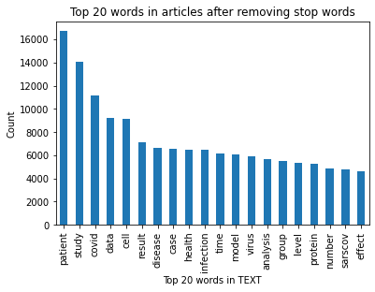
Initial EDA (v1.1) -
This are the top 20 words from all the articles and their count

Slide 11
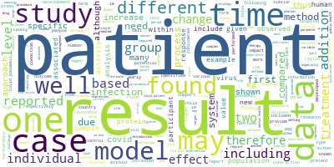
Initial EDA results
Word cloud shows most used words

Slide 12
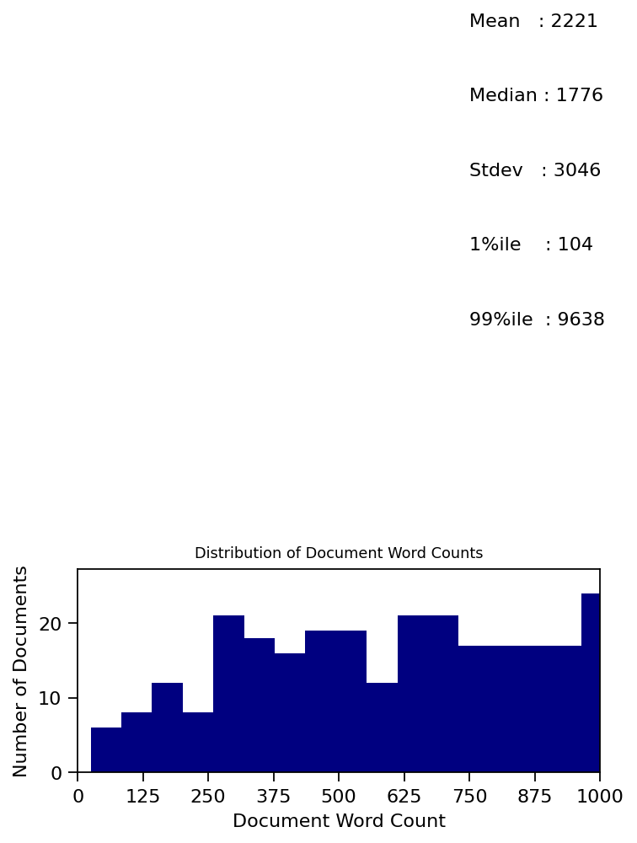
Distribution of Document Word Count
Descriptive statistcis of word count of documents

Slide 13
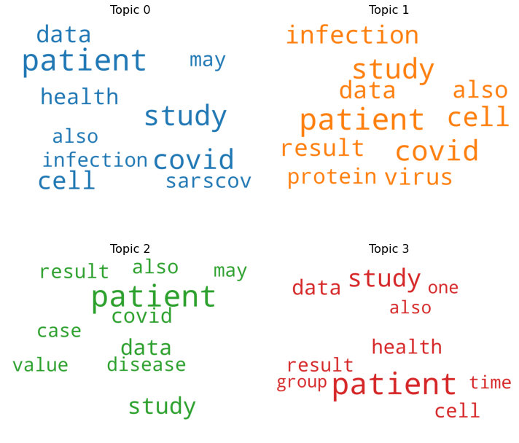
Word Cloud by Topic
Word Cloud topic wise

Slide 14
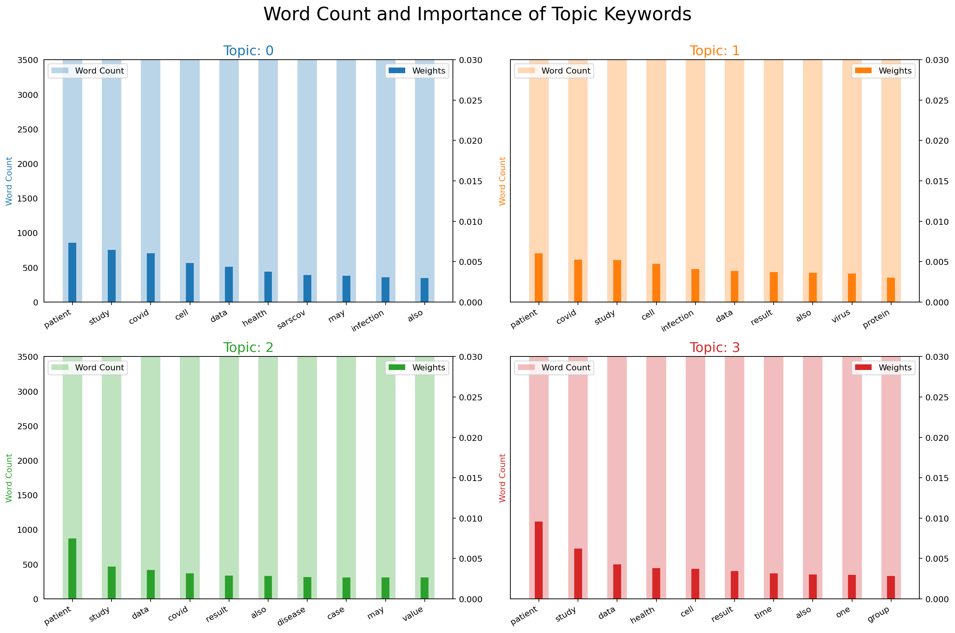
Importance of topic keywords
The graph shows how frequently the word has appeared topic wise

Slide 15
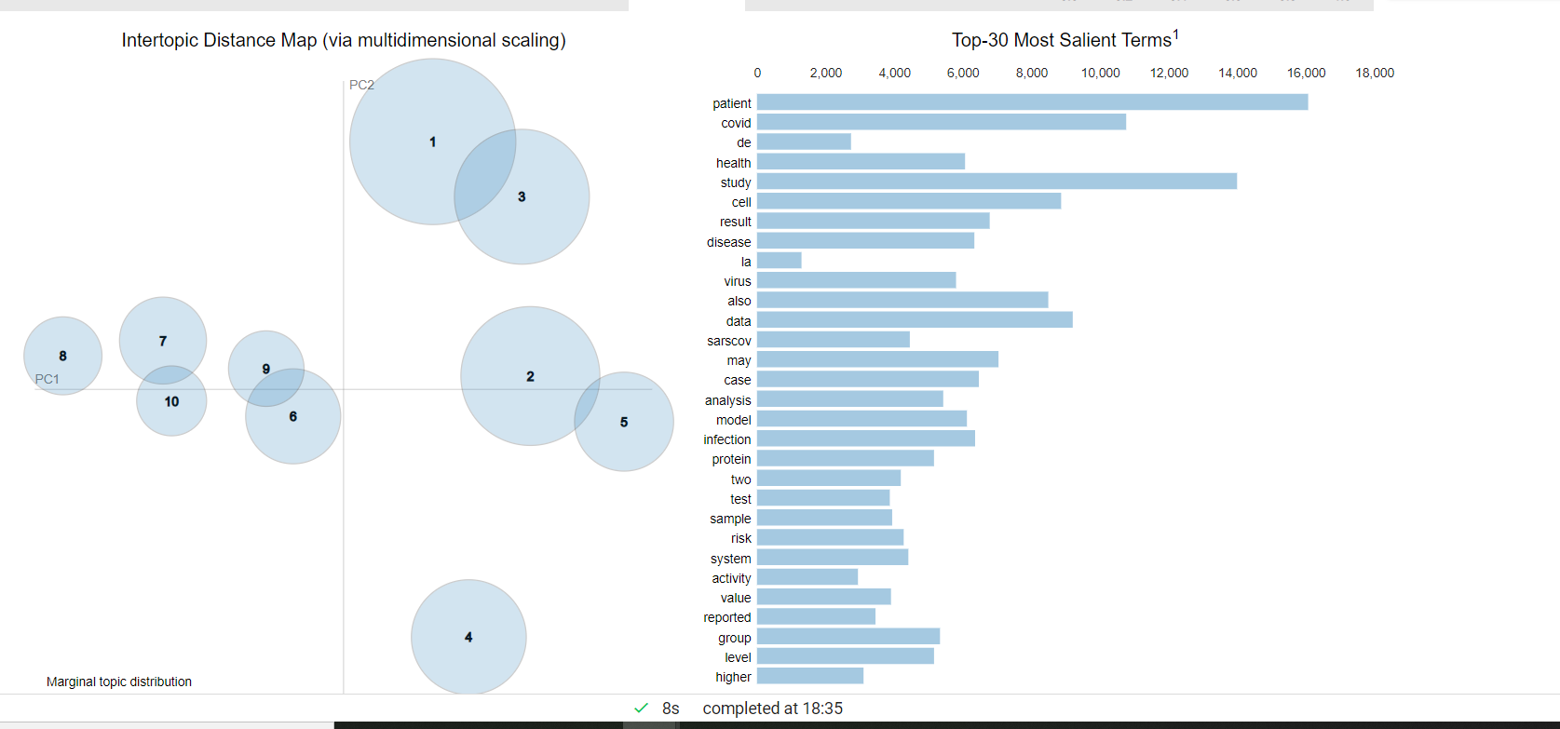
LDA

Slide 16
Next Step
Use T5 (transfer learning model) to train
Perform Sentiment Analysis using NLTK VADER
Creating interactive webpage using ‘streamlit’

Slide 17
Expected Outcomes
Get summarized text of research articles
Sentiment Analysis
Interactive dashboard wherein user can input covid-19 research article and get a summarized text

Slide 18
References
https://github.com/allenai/cord19
https://ai2-semanticscholar-cord-19.s3-us-west-2.amazonaws.com/historical_releases.html
http://cs230.stanford.edu/projects_spring_2020/reports/38954132.pdf
https://medium.com/swlh/text-summarization-guide-exploratory-data-analysis-on-text-data-4e22ce2dd6ad
https://medium.com/@nqabell89/visualizing-unsupervised-text-classification-output-with-pyldavis-370c1784ed58

